Slide 1
Information Retrieval and Web Search
Vasile Rus, PhD
vrus@memphis.edu
www.cs.memphis.edu/~vrus/teaching/ir-websearch/

Slide 2
Outline
Announcements
Text Properties

Slide 3
Text
Main form of communicating knowledge
Document = Unit of information
  Mostly text
Document
  Syntax
  Structure
  Semantics
  Presentation style
  Metadata

Slide 4
Statistical Properties of Text
How is the frequency of different words distributed?
How fast does vocabulary size grow with the size of a corpus?
Such factors affect the performance of information retrieval and can be used to select appropriate term weights and other aspects of an IR system

Slide 5
Word Frequency
A few words are very common
  2 most frequent words (e.g. “the”, “of”) can account for about 10% of word occurrences.
Most words are very rare
  Half the words in a corpus appear only once, called hapax legomena (Greek for “read only once”)
Called a “heavy tailed” distribution, since most of the probability mass is in the “tail”

Slide 6
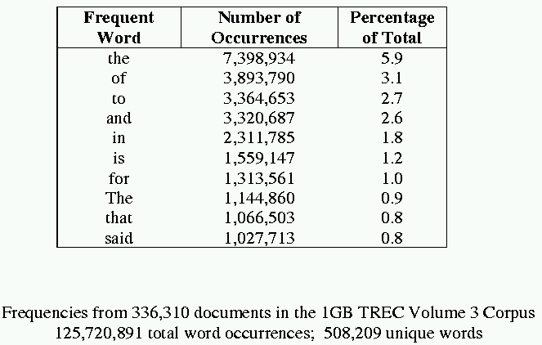
Sample Word Frequency Data
(from B. Croft, UMass)

Slide 7
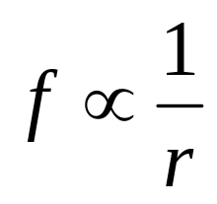
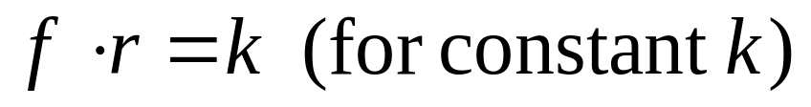
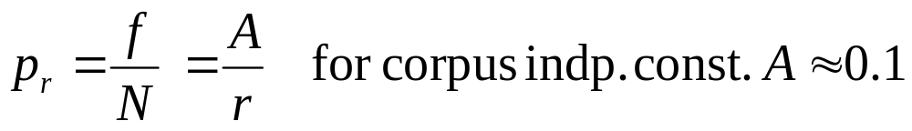
Zipf’s Law
Rank (r): The numerical position of a word in a list sorted by decreasing frequency (f )
Zipf (1949) “discovered” that:
If probability of word of rank r is p_{r} and N is the total number of word occurrences:

Slide 8
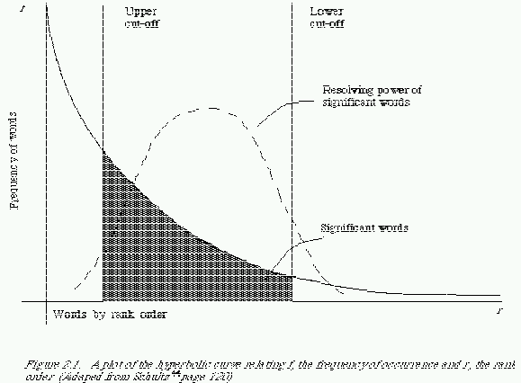
Zipf and Term Weighting
Luhn (1958) suggested that both extremely common and extremely uncommon words were not very useful for indexing

Slide 9
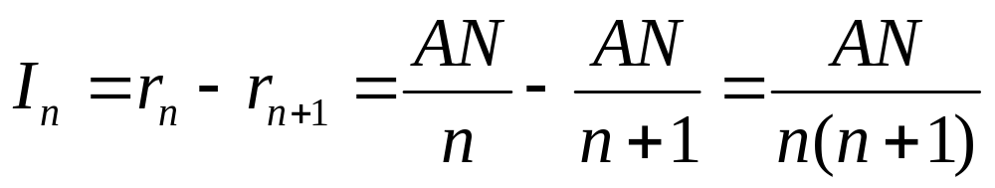
Predicting Occurrence Frequencies
By Zipf, a word appearing n times has rank r_{n}=AN/n
Several words may occur n times, assume rank r_{n} applies to the last of these
Therefore, r_{n} words occur n or more times and r_{n+1} words occur n+1 or more times
So, the number of words appearing exactly n times is:

Slide 10
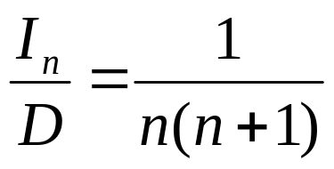
Predicting Word Frequencies (cont)
Assume highest ranking term occurs once and therefore has rank D = AN/1
Fraction of words with frequency n is:
Fraction of words appearing only once is therefore ½.

Slide 11
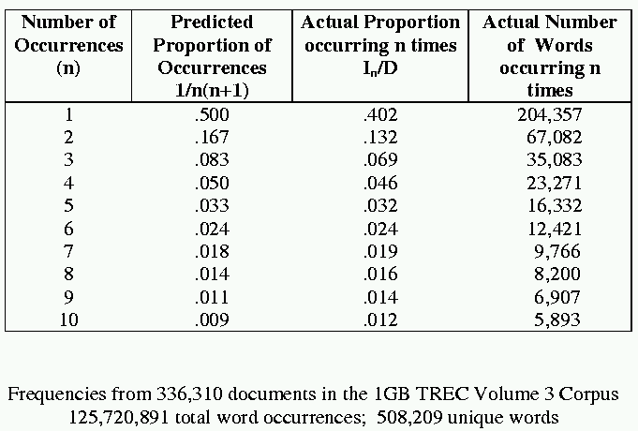
Occurrence Frequency Data
(from B. Croft, UMass)

Slide 12
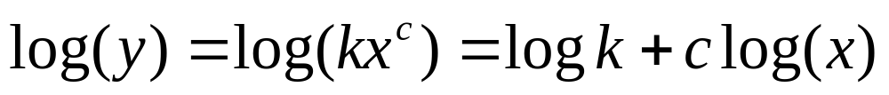
Does Real Data Fit Zipf’s Law?
A law of the form y = kx^{c} is called a power law.
Zipf’s law is a power law with c = –1
On a log-log plot, power laws give a straight line with slope c.
Zipf is quite accurate except for very high and low rank.

Slide 13
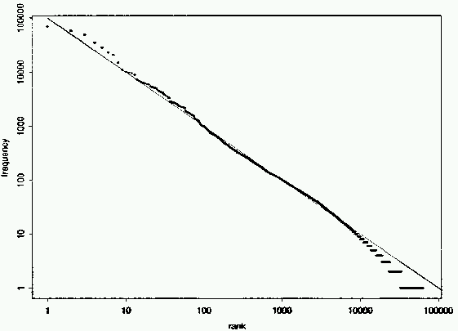
Fit to Zipf for Brown Corpus
k = 100,000

Slide 14
Mandelbrot (1954) Correction
The following more general form gives a bit better fit:

Slide 15
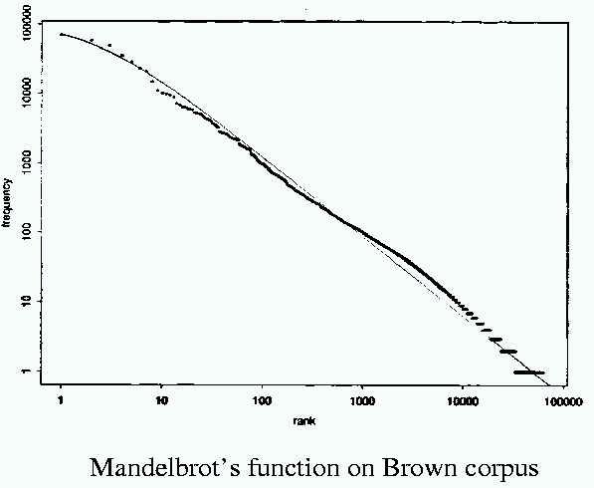
Mandelbrot Fit
P = 10^{5.4}, B = 1.15, ρ = 100

Slide 16
Explanations for Zipf’s Law
Zipf’s explanation was his “principle of least effort.” Balance between speaker’s desire for a small vocabulary and hearer’s desire for a large one.
Debate (1955-61) between Mandelbrot and H. Simon over explanation.
Li (1992) shows that just random typing of letters including a space will generate “words” with a Zipfian distribution.
  http://linkage.rockefeller.edu/wli/zipf/ (OLD)
  http://www.nslij-genetics.org/wli/zipf/index.html (NEW)

Slide 17
Zipf’s Law Impact on IR
Good News: Stopwords will account for a large fraction of text so eliminating them greatly reduces inverted-index storage costs.
Bad News: For most words, gathering sufficient data for meaningful statistical analysis (e.g. for correlation analysis for query expansion) is difficult since they are extremely rare.

Slide 18
Vocabulary Growth
How does the size of the overall vocabulary (number of unique words) grow with the size of the corpus?
This determines how the size of the inverted index will scale with the size of the corpus.
Vocabulary not really upper-bounded due to proper names, typos, etc.

Slide 19
Heaps’ Law
If V is the size of the vocabulary and the n is the length of the corpus in words:
Typical constants:
  K ≈ 10−100
  β ≈ 0.4−0.6 (approx. square-root)

Slide 20
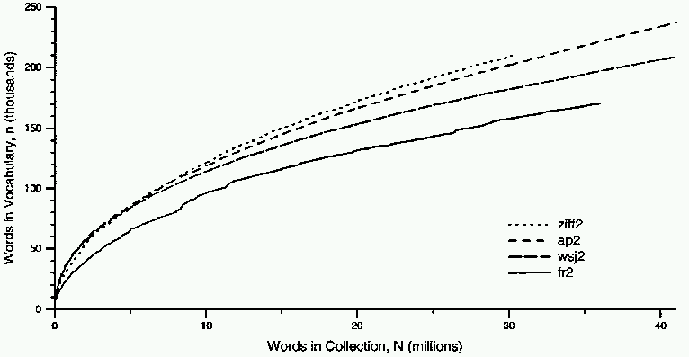
Heaps’ Law Data

Slide 21
Explanation for Heaps’ Law
Can be derived from Zipf’s law by assuming documents are generated by randomly sampling words from a Zipfian distribution.

Slide 22
Electronic Texts
7-bit EBDCDIC
8-bit standard ASCII
16-bit or more Unicode
RTF – Rich Text Format
PDF – Portable Document Format
Postscript – programming language for drawing
MIME – Multipurpose Internet Mail Exchange\
Text compression formats
  Compress
  ARJ
  ZIP

Slide 23
String Similarity
Hamming distance
  Number of mismatched characters
Levenshtein distance
longest common subsequence
  Not necessarily contiguous but in the same order

Slide 24
Metadata
Information about a document that may not be a part of the document itself (data about data)
Descriptive metadata is external to the meaning of the document:
  Author
  Title
  Source (book, magazine, newspaper, journal)
  Date
  ISBN
  Publisher
  Length

Slide 25
Metadata (cont’d)
Semantic metadata concerns the content:
  Abstract
  Keywords
  Subject Codes
    Library of Congress
    Dewey Decimal
    UMLS (Unified Medical Language System)
Subject terms may come from specific ontologies (hierarchical taxonomies of standardized semantic terms)

Slide 26
Web Metadata
META tag in HTML
  <META NAME=“keywords” CONTENT=“pets, cats, dogs”>
META “HTTP-EQUIV” attribute allows server or browser to access information:
  <META HTTP-EQUIV=“content-type” CONTENT=“text/tml; charset=EUC-2”>
  <META HTTP-EQUIV=“expires” CONTENT=“Tue, 01 Jan 02”>
  <META HTTP-EQUIV=“creation-date” CONTENT=“23-Sep-01”>

Slide 27
Content Rating Metadata
PICS (Platform for Internet Content Selection)
Rating system to allow censoring based on sexual, violent, language etc. content.
  <META HTTP-EQUIV=“PICS-label” CONTENT=“PG13: SEX, VIOLENCE”>

Slide 28
RDF
Resource Description Framework
XML compatible metadata format
New standard for web metadata
  Content description
  Collection description
  Privacy information
  Intellectual property rights (e.g. copyright)
  Content ratings
  Digital signatures for authority/authentication

Slide 29
RDF
Web of resources
Resource
  URI – Uniform Resource Identifier; e.g. URL

Slide 30
Markup Languages
Language used to annotate documents with “tags” that indicate layout or semantic information
Most document languages (Word, RTF, Latex, HTML) primarily define layout
History of Generalized Markup Languages:
Standard
eXtensible
GML(1969)
SGML (1985)
XML (1998)
HTML (1993)
HyperText

Slide 31
Basic SGML Document Syntax
Blocks of text surrounded by start and end tags.
  <tagname attribute=value attribute=value …>
  </tagname>
Tagged blocks can be nested.
In HTML end tag is not always necessary, but in XML it is.

Slide 32
HTML
Developed for hypertext on the web.
  <a href=“http://www.cs.memphis.edu”>
May include code such as Javascript in Dynamic HTML (DHTML)
Separates layout somewhat by using style sheets (Cascade Style Sheets, CSS)
However, primarily defines layout and formatting

Slide 33
XML
Like SGML, a metalanguage for defining specific document languages
Simplification of original SGML for the web promoted by WWW Consortium (W3C)
Fully separates semantic information and layout
Provides structured data (such as a relational DB) in a document format
Replacement for an explicit database schema

Slide 34
XML (cont)
Allows programs to easily interpret information in a document, as opposed to HTML, which was intended as layout language for formatting docs for human consumption
New tags are defined as needed
Structures can be nested arbitrarily deep
Separate (optional) Document Type Definition (DTD) defines tags and document grammar

Slide 35
XML Example
<person>
<name> <firstname>John</firstname>
<middlename/>
<lastname>Doe</lastname>
</name>
<age> 38 </age>
<email> jdoe@austin.rr.com</email>
</person>
<tag/> is shorthand for empty tag <tag></tag>
Tag names are case-sensitive (unlike HTML)
A tagged piece of text is called an element.

Slide 36
XML Example with Attributes
<product type=“food”>
<name language=“Spanish”>arroz con pollo</name>
<price currency=“peso”>2.30</price>
</product>
Attribute values must be strings enclosed in quotes.
For a given tag, an attribute name can only appear once.

Slide 37
XML Miscellaneous
XML Document must start with a special tag.
  <?XML VERSION=“1.0”>
Tag “id” and “idref” attributes allow specifying graph-structured data as well as tree-structured data.
<state id=“s2”>
<abbrev> TX</abbrev>
<name>Texas</abbrev>
</state>
<city id=“c2”>
<aircode> AUS </aircode>
<name> Austin </name>
<state idref=“s2”/>
</city>

Slide 38
Document Type Definition (DTD)
Grammar or schema for defining the tags and structure of a particular document type
Allows defining structure of a document element using a regular expression
Expression defining an element can be recursive, allowing the expressive power of a context-free grammar

Slide 39
DTD Example
<!DOCTYPE db [
<!ELEMENT db (person*)>
<!ELEMENT person (name,age,(parent | guardian)?>
<!ELEMENT name (#PCDATA)>
<!ELEMENT age (#PCDATA)>
<!ELEMENT parent (person)>
<!ELEMENT guardian (person)>
]>
*: 0 or more repetitions
?: 0 or 1 (optional)
| : alternation (or)
PCDATA: Parsed Character Data (may contain tags)

Slide 40
Sample Valid Document for DTD
<db>
<person>
<name> <firstname>John</firstname> <lastname>Doe</lastname>
</name>
<age> 26 </age>
<parent>
<person>
<name><firstname>Robert</firstname> <lastname>Doe</firstname>
</name>
<age> 55</age>
</person>
</parent>
</person>
</db>

Slide 41
DTD (cont)
Tag attributes are also defined:
<!ATTLIS name language CDATA #REQUIRED>
<!ATTLIS price currency CDATA #IMPLIED>
CDATA: Character data (string)
IMPLIED: Optional
Can define DTD in a separate file:
<!DOCTYPE db SYSTEM “/u/doe/xml/db.dtd”>

Slide 42
XSL (Extensible Style-sheet Language)
Defines layout for XML documents.
Defines how to translate XML into HTML.
Define style sheet in document:
  <?xml-stylesheet href=“mystyle.css” type=“text/css”>

Slide 43
XML Standardized DTD’s
MathML: For mathematical formulae
SMIL (Synchronized Multimedia Integration Language): Scheduling language for web-based multi-media presentations
RDF
TEI (Text Encoding Initiative): For literary works
NITF: For news articles
CML: For chemicals
AIML: For astronomical instruments

Slide 44
Parsing XML
Process XML file into an internal data format for further processing
SAX (Simple API for XML): Reads the flow of XML text, detecting events (e.g. tag start and end) that are sent back to the application for processing
DOM (Document Object Model): Parses XML text into a tree-structured object-oriented data structure

Slide 45
DOM
XML document represented as a tree of Node objects (e.g. Java objects)
Node class has subclasses:
  Element
  Attribute
  CharacterData
Node has methods:
  getParentNode()
  getChildNodes()

Slide 46
Sample DOM Tree
person
Element
name
age
parent
Character-Data
firstname
lastname
26
person
John
Doe
name
age
firstname
lastname
55
Robert
Doe

Slide 47
More Node Methods
Element node
  getTagName()
  getAttributes()
  getAttribute(String name)
CharacterData node
  getData()
Also methods for adding and deleting nodes and text in the DOM tree, setting attributes, etc.

Slide 48
XML Parsers
Perl XML Parser
http://www.xml.com/pub/a/98/09/xml-perl.html
Apache Xerxes XML Parser
  http://xml.apache.org/
  Parser for creating DOM trees for XML documents
  Java version available at:
    http://xml.apache.org/xerxes-j/
  Full Javadoc available at:
    http://xml.apache.org/xerxes-j/apiDocs/

Slide 49
Summary
Text Properties

Slide 50
Next
Text Operations

